Slide 1
Fall 2020
DATS 501 Fundamentals of Data Science
Hasan Demirtaş
hdemirtas.academic@gmail.com

Slide 2
Decision Theory cont.

Slide 3
Cognitive Biases cont.

Slide 4
Endowment Effect
How information is framed (shown) affects our choices
Positive expressions are more effective on average human

Slide 5
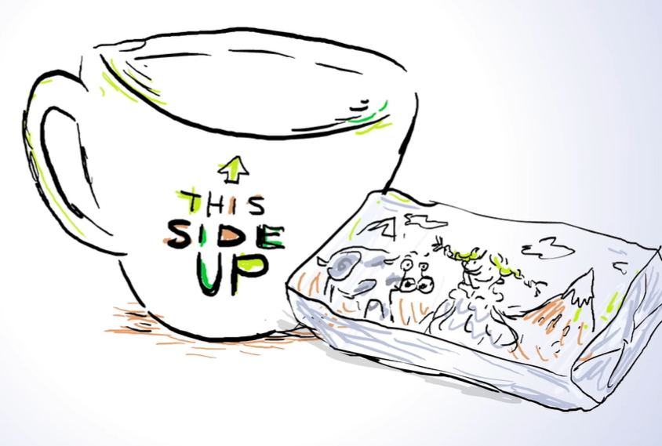
Endowment Effect
Students were asked to choose between a coffe mug and chocolate bar for helping a science experiment

Slide 6
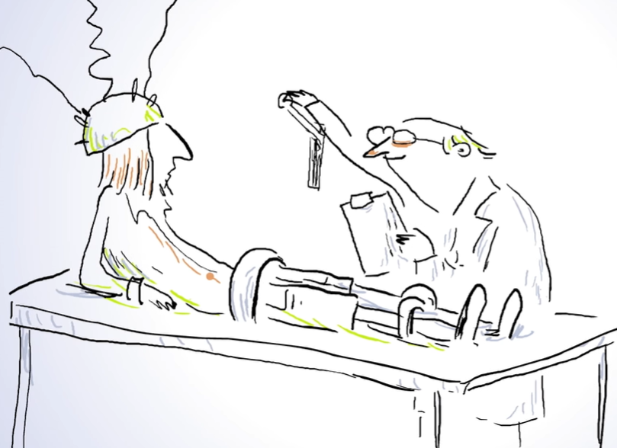
Endowment Effect
Students were asked to choose between a coffe mug and chocolate bar for helping a science experiment

Slide 7
Endowment Effect
A group of students were asked to choose between a coffe mug and chocolate bar for helping a science experiment

Slide 8
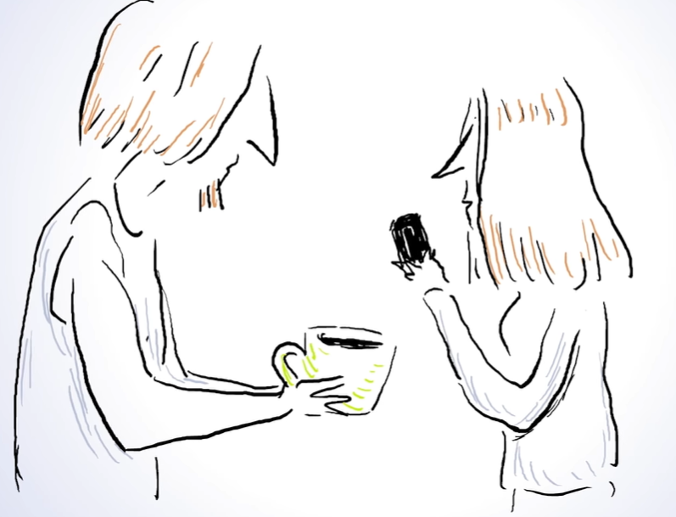
Endowment Effect
Half chosed the mug, half chosed the bar -> They valued the items similarly

Slide 9
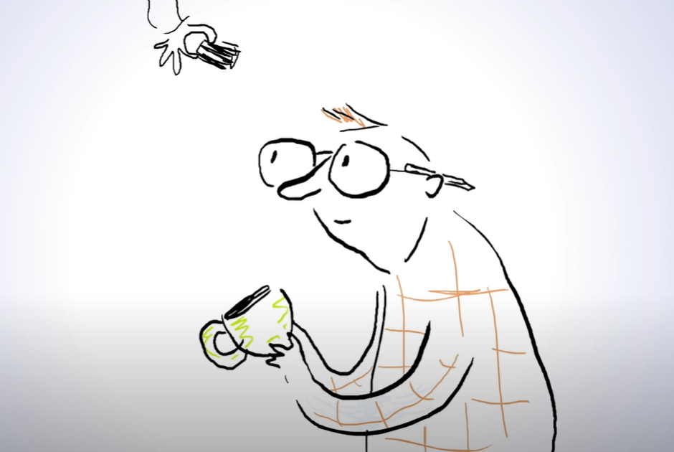
Endowment Effect
Some other group of students were given a mug first and chance to swap it for a chocolate bar

Slide 10
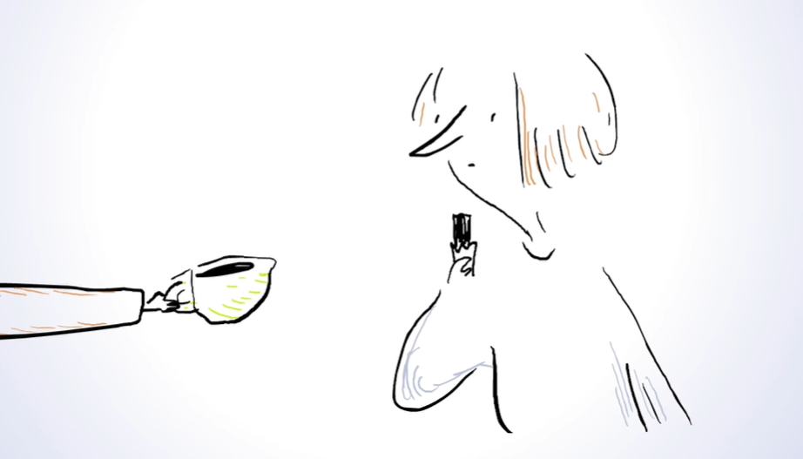
Endowment Effect
Same is done for chocolate bar also

Slide 11
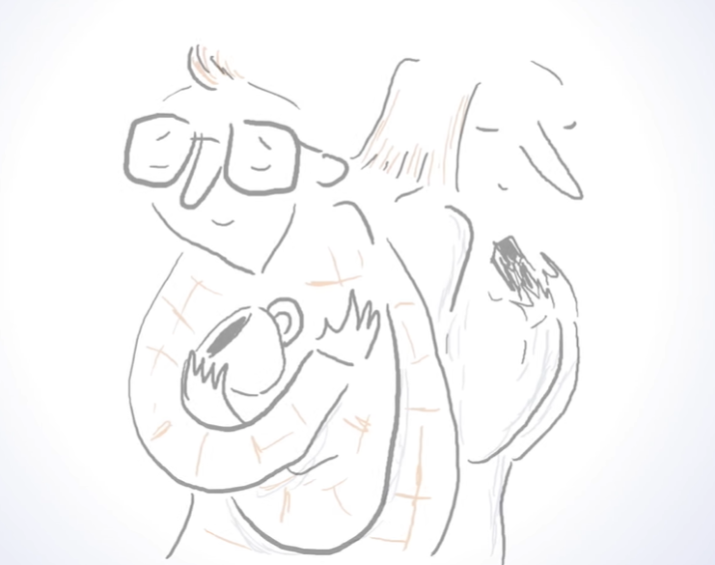
Endowment Effect
They mostly have chosen to keep the initial choice

Slide 12
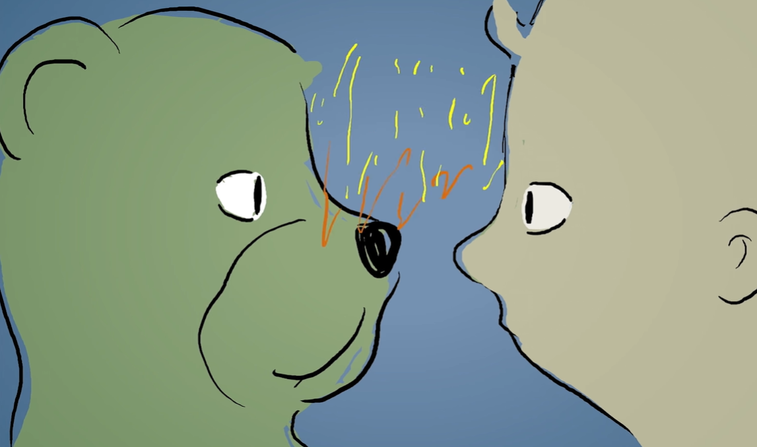
Endowment Effect
We quickly form connection at neural level

Slide 13
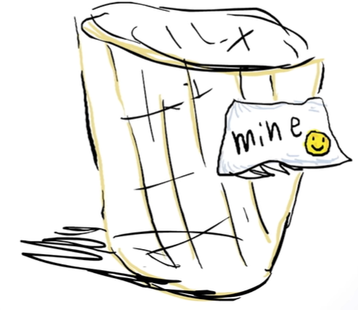
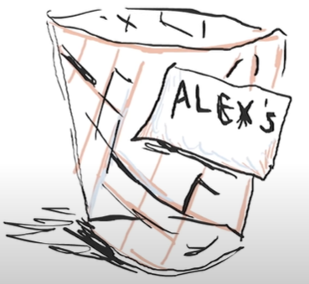
Endowment Effect
Even a single label affects our perception

Slide 14
Endowment Effect
Even a single label affects our perception

Slide 15
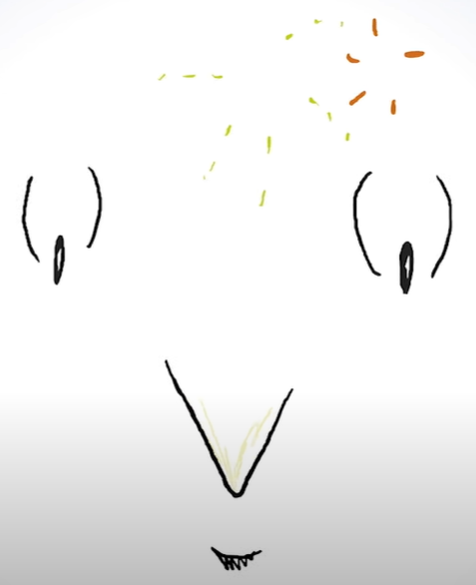
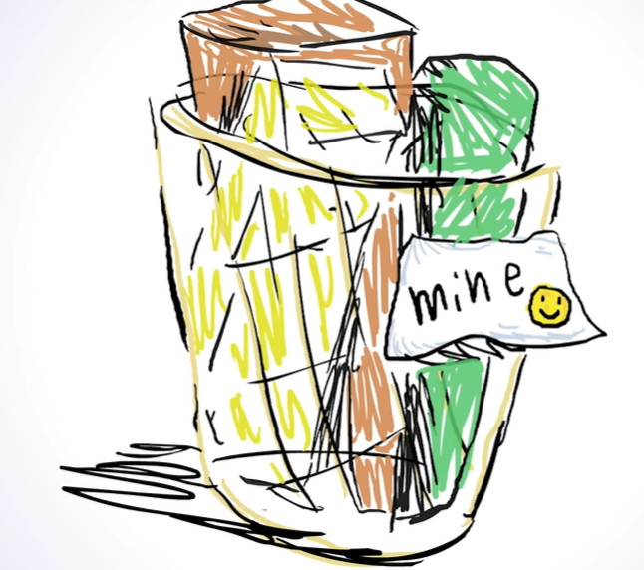
Endowment Effect
Putting items in the basket activates our brain

Slide 16
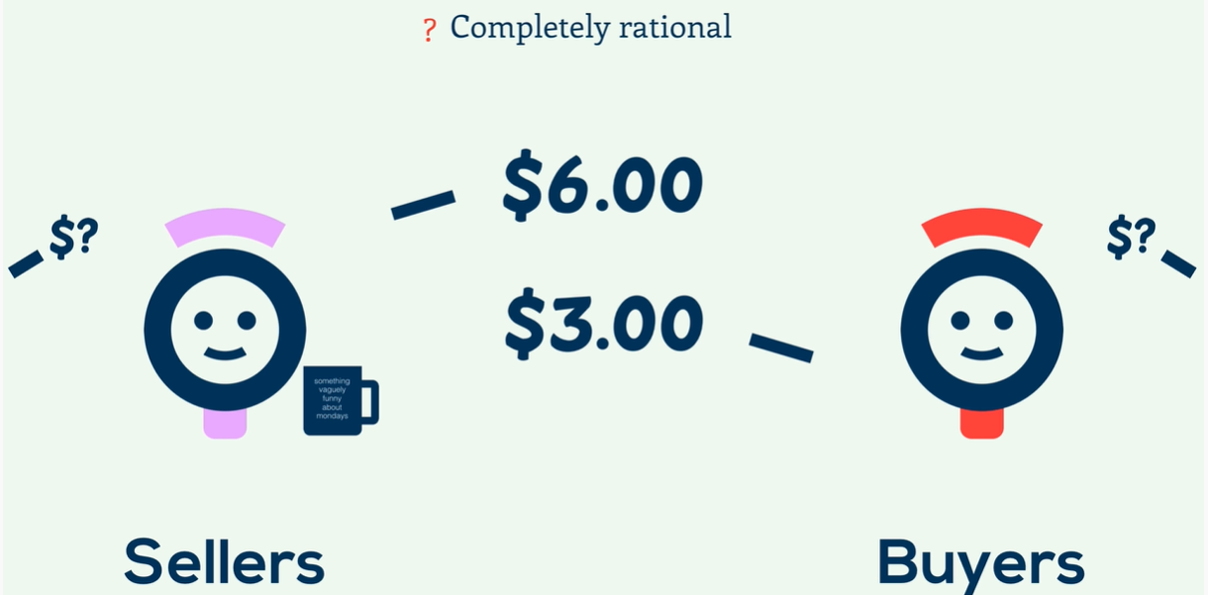
Endowment Effect
Sellers vs Buyers

Slide 17
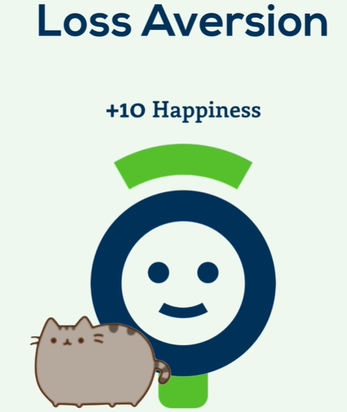
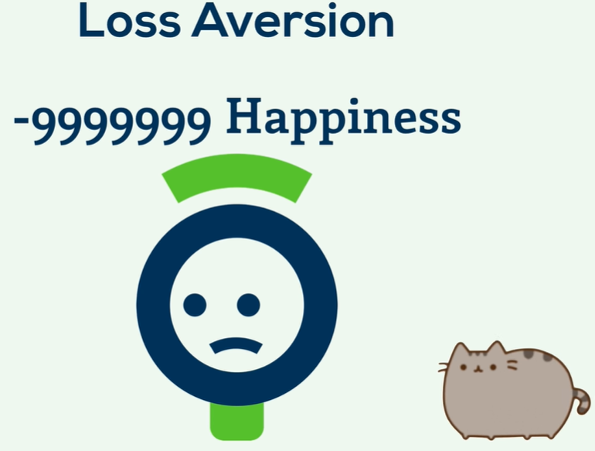
Endowment Effect
Loss aversion nature

Slide 18
Endowment Effect
Loss aversion nature

Slide 19

Endowment Effect
Marketing: Trial rooms, free trials, free samples

Slide 20



Endowment Effect
Accepting new tech and leaving legacy may be challenging

Slide 21
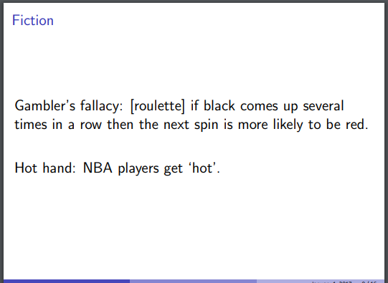
Gambler’s fallacy
A bias example

Slide 22
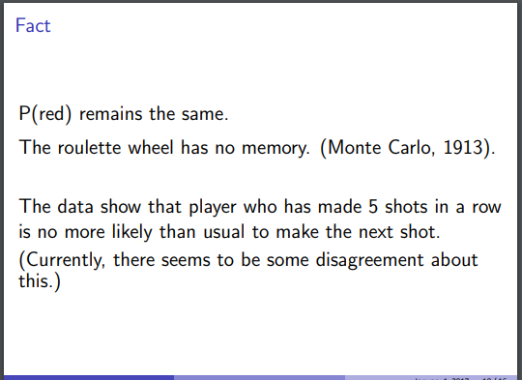
Gambler’s fallacy
A bias example

Slide 23
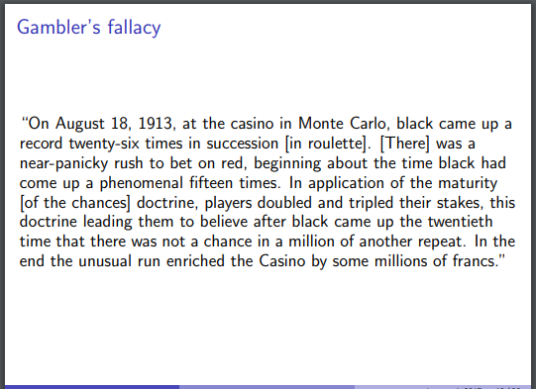
Gambler’s fallacy
A bias example

Slide 24
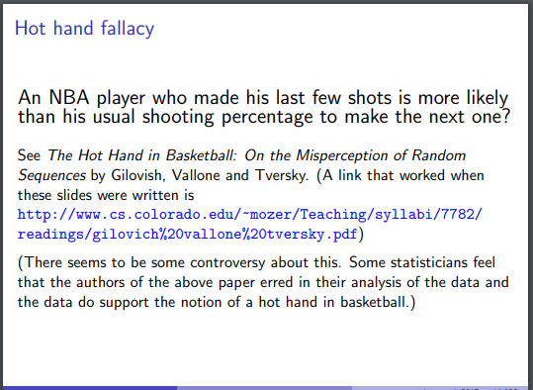
Gambler’s fallacy
Hot hand fallacy is like Gambler’s fallacy

